Slide 1

POST FINANCIAL SERVICE WEBSITE DOMAIN :WEB DEVELOPMENT

Slide 2
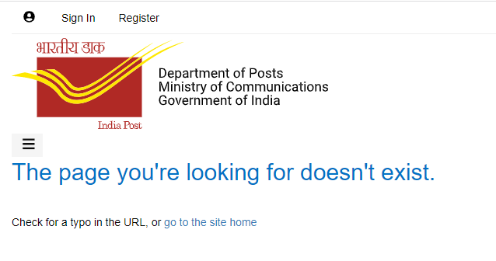
WHY??? HAVE WE SELECTED THIS IDEA? THERE IS NO SUCH WEBSITE AVAILABLE FOR THE FINANCIAL SCHEMES OR INVESTMENTS .THERE IS 0% ADV DUE TO THIS POST OFFICE IS LAGGING BEHIND EVEN AFTER BEGIN THE MOST SECURE OPTION FOR INVESTMENT. THIS WEBSITE WILL BE PLATFORM WHICH WILL MAKE THE CUSTOMER MORE AWARE AND WILL CONNECT THE AGENT AND CUSTOMER.

Slide 3
PROBLEM STATEMENT :
A customer wants to invest in post,but has no idea how to do ,and does not even have sufficient time to do these things ie choice the best schemes ,do the documentation,making rounds of post office again and again.
In short the user wants this government prodecure to be handy and easier
The customer doesn’t know which agent to contact or does he have the lincese provided by the government for his agency.
What after the investment of money can he keep a track on it like (maturity)

Slide 4
WHY AN AGENT IS REQUIRED?
WITHOUT AGENT:
CUSTOMER
DO ALL THE PROCESS BY YOUR SELF(FROM DOCUMENTATON TILL MATURITY)
RETURNS=P.A+INTEREST
RETURNS=P.A+INTEREST+COMISION
CUSTOMER
ALL THE WORK DONE BY AGENT
GOV COMMISSION
WITH AGENT :

Slide 5
Project idea!!!!
The basic idea of the website is that it is platform which will connect the government agent and the customer/investor.
This website will help the government agent to increase there reach as they will get connected to people who are interested to invest in postal schemes.
The customer will get a clear idea that in what should they invest ,the pros and cons of the schemes
The customers can filter the schemes according to their requirements.
The customer will be up to date once he invests,and can check out the website whenever required.

Slide 6
USER
AGENT
CUSTOMER
REGISTER
CHART
LOGIN
AGENT LIST
DIVIDE AS PER AREA AND SCHEME SERVICE
MY CUSTOMERS
CUSTOMIZE SCHEMES
CALCULATE PREMINUM
WANT US TO CONTACT YOU
AGE
GENDER

Slide 7
How we will deal the problem statement?
When the user enters the website two option will be displayed
Agent login :When an agents register them the agents will be divided as per their area(license of post area) and the schemes that they work on .
Customer login: when the customers logins various option will be displayed like scheme chart ,premimun calculator ,filter schemes connect with agent .
When the customers clicks connect with agent ,the website will match the address of the customer and the agent and a list of agent whos areas have matched with customers ,a list of that agents will be displayed
And once the agent is connected all processes will be done by the agent without the customer stepping out of the door .
And for an option of security/transparency the customer will be daily updated about the details by the agent.

Slide 8
INTERFACE OF AGENT
UPDATION
CONTACT NEWLY ADDED CUSTOMERS
FALL UP PAST CUSTOMERS
SCHEME LIST
CUSTOMERS LIST ACCORDING TO SCHEMES

Slide 9
INTERFACE OF INVESTOR
MY AGENT
HOME
MY AGENT
SCHEMES HE INVESTED IN .
NEW SCHEME
MATURITY.
COMPLAINTS
TOTAL AMOUNT .
INFORMATION OF AGENT

Slide 10
HOW WILL WE USE DATA OF THE CUSTOMERS WHICH IS COLLECTED????? WE WILL USE DATA FOR THEIR FALL UP. Eg:IF nishant has invest money at the age of 56years.so we can call him again after 4 –5 when is 61yr ,and convence him to invest in senior citizen scheme.
FUTURE SCOPE

